Slide 1

Meet Ironman Software
Notes:
Slide 0: this slide will not automatically turned over. Show this BEFORE the acutal presentation starts.

Slide 2
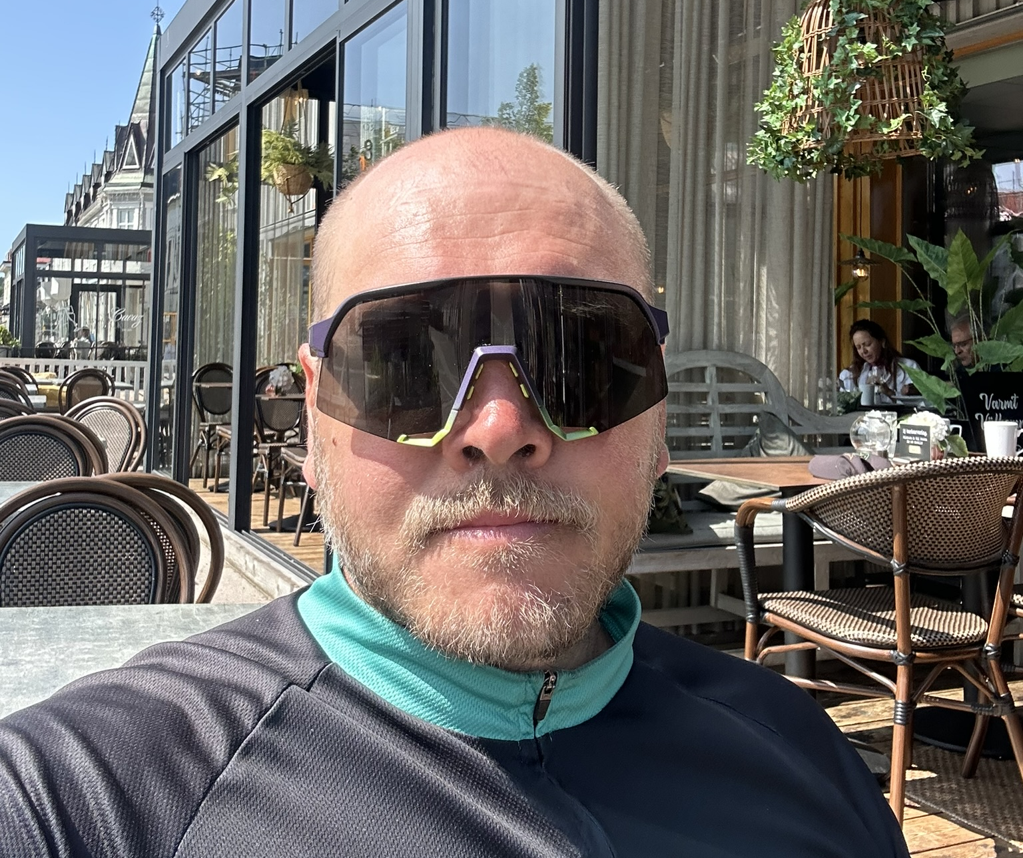
About Me
Owner of Ironman Software
Inventor of PowerShell Universal
Former PowerShell MVP
Blogger
Author
YouTuber
Open-Source Contributor
Hobby Collector

Slide 3
PowerShell Universal
Script Execution and Scheduling
HTTP REST APIs and OpenAPI Documentation
Extensive Web UI application framework
Git integration and code-based deployments
Enterprise Security with SAML2, OpenID Connect, and more
Role-based and fine-grained authorization

Slide 4
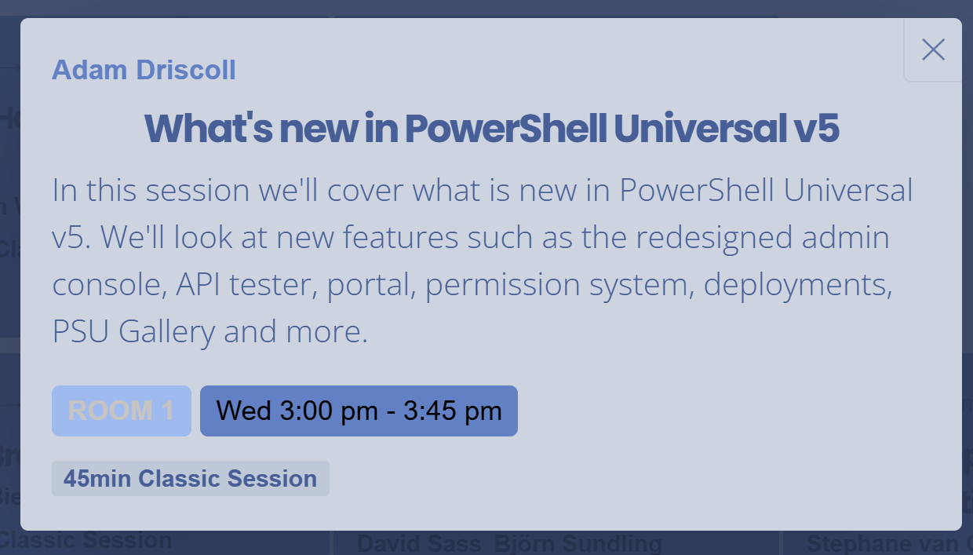
PowerShell Universal Session

Slide 5
Demo

